Slide 1
What is the Poverty Line?
“What is the Poverty Line Presentation” by Erin Lilli, PhD at eelilli.org is licensed under CC BY-NC-SA 4.0

Slide 2
What is the Poverty Line?
The government uses the poverty line (or threshold) to determine who is in poverty and who is not in poverty (or who is near poverty). If your income is under the threshold (for your family size) than you/your family are considered to be “in poverty”. This is how the government counts how many people are in, out of, or near poverty.
  The poverty threshold is adjusted by family size (e.g., a family of four needs to earn at least $31,200 to be considered not in poverty as of 2024).
  The poverty threshold does not adjust by location in the contiguous 50 states. This means, for instance, that the same family of four is considered in poverty if they make below $31,200 whether they live in Muskogee, Oklahoma or Brooklyn - even though the cost of living n Brooklyn is way higher!
The official US poverty threshold is created based on 3x what the average family of ‘x’ number spends on food. For example, the poverty threshold for a family of one (single person) is $15,060; thus, this person is assumed to spend about $5,020 on food a year ($418/month).
  You can visit this link to see the 2024 poverty thresholds.
Notes:
Link: https://aspe.hhs.gov/topics/poverty-economic-mobility/poverty-guidelines

Slide 3
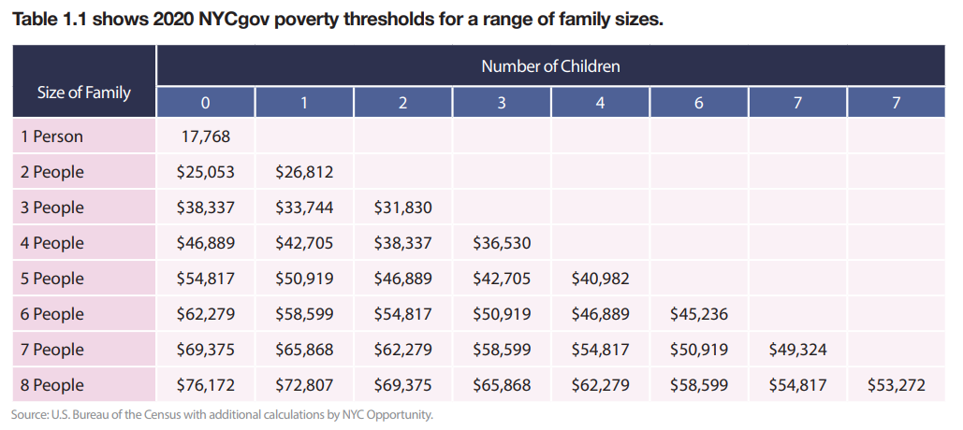
There is an alternative way to measure poverty that takes into account not just your income, but also any social welfare benefits you might receive (eg. TANF, SNAP, EITC, WIC etc. and expenses (like taxes) that you have.
NYC has a version of this ‘alternative’ measuring strategy so they can get a more accurate picture of how many people are in poverty in NYC.
  This allows us to see how helpful these benefits are at bringing people out of poverty or where more help/access to benefits (or better benefits) is needed.
  Here’s a link NYC Opportunity’s Report: New York City Government Poverty Measure 2020 (most recent I could find!...COVID impact).
Compare to the Federal threshold of $31,200

Slide 4
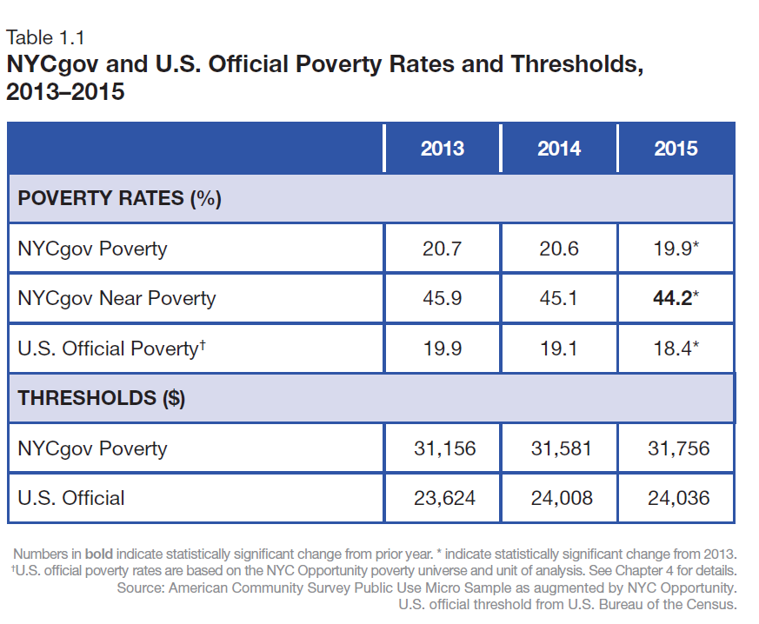
2-adult, 2-child family of four

Slide 5
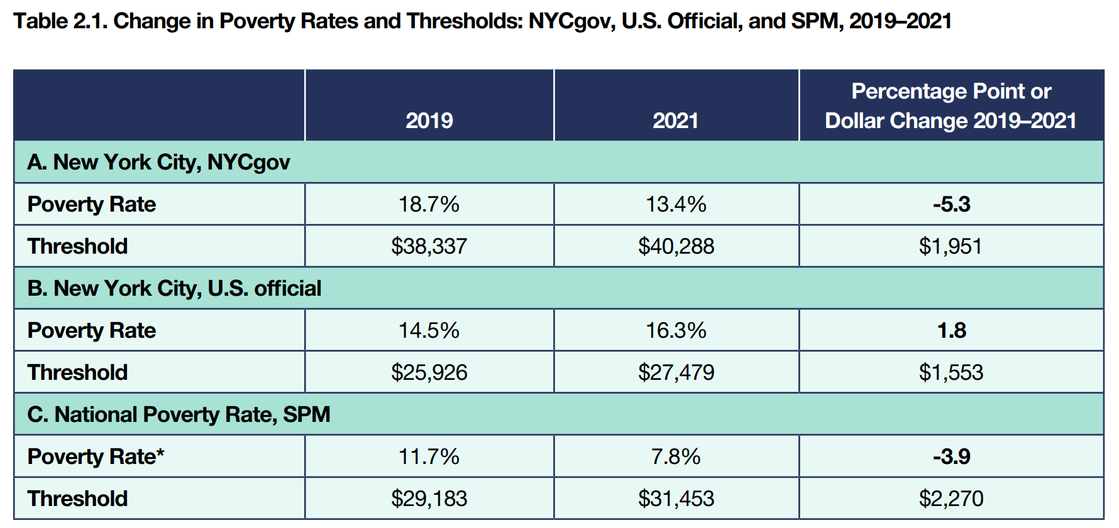
Given what we’ve learned about the issues with the OPM – can you think of why it showed an increase in poverty during COVID, when the other measures did not?
Notes:
“Table 2.1 compares the poverty rates and thresholds of the NYCgov measure to the U.S. official measure and to the SPM. The table shows a critical difference in the two ways of measuring poverty. The NYCgov measure at the city level and the SPM at the national level both show large and statistically significant drops in the poverty rate from 2019 to 2021. Both measures account for Covid-19 pandemic relief benefits. In New York City, these programs contributed to a 5.3 percentage point decline in the poverty rate. This represents over 400,000 New Yorkers who moved out of poverty during the pandemic. The official measure, because it does not include most of the pandemic benefits, shows a statistically significant increase in the poverty rate for New York City”
__________
Sources:
https://www.nyc.gov/assets/opportunity/pdf/Poverty-2021.pdf
: American Community Survey Public Use Micro Sample as augmented by NYC Opportunity. Official poverty rates for New York City are based on the NYCgov poverty universe and unit of analysis and differ from published U.S. poverty data. SPM poverty rates are from Creamer et. al., 2022. See: https://www.census.gov/content/dam/Census/library/ publications/2022/demo/p60-277.pdf. Notes: Changes are measured in percenta

Slide 6
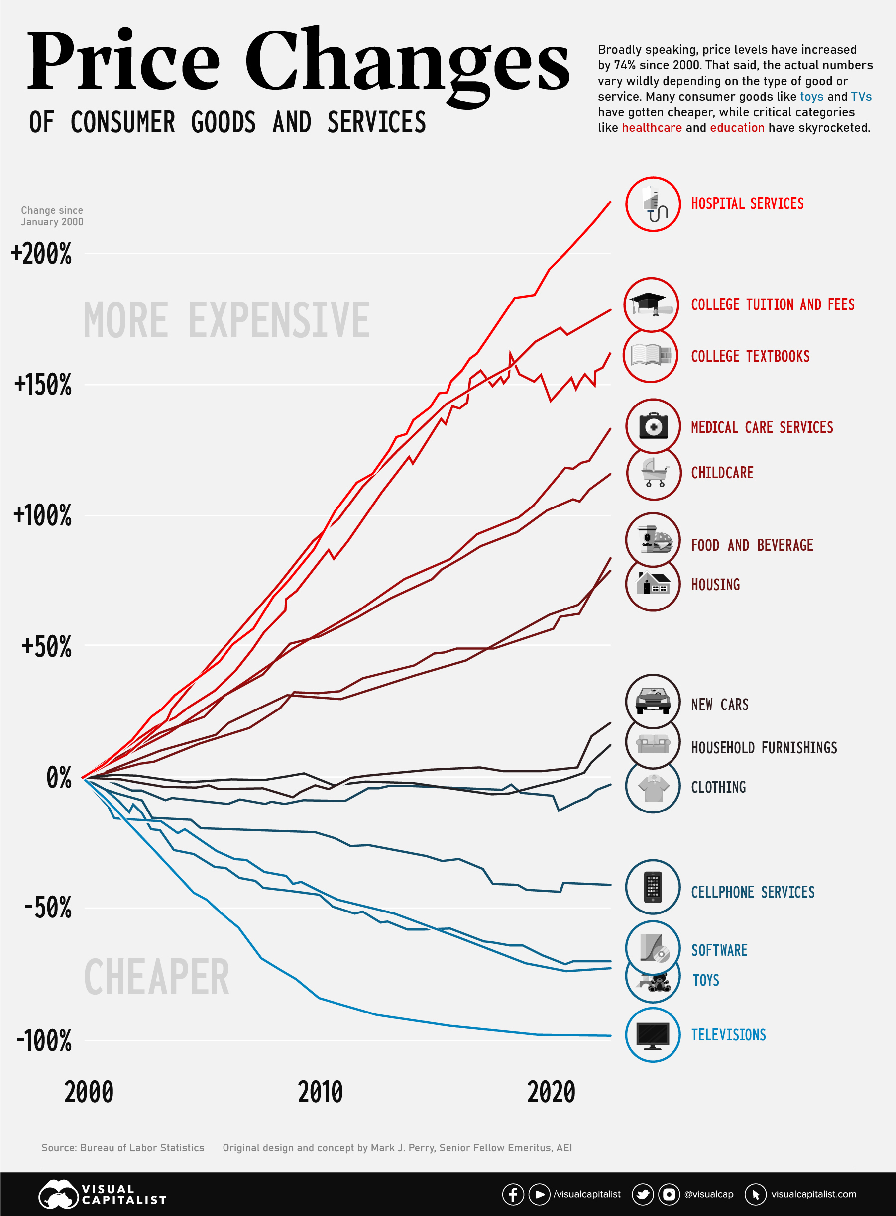
Basic Needs?
CALCULATING A POVERTY THRESHOLD
Family of __ = __ working adults + __ children (ages: ___)
Essential “Barebones” Expenses
  Rent = $/mo
  Utilities = $/mo
  Food = $/mo
  Transportation = $/mo
  Childcare = $/mo
  Cell phone services = $/mo
  Savings/Medical = $/mo
  Other Expenses…
  ___________________________________________
TOTAL MONTHLY EXPENSES = $/MO
TOTAL ANNUAL SALARY NECESSESARY TO COVER THIS FAMILY = $_____
Does this family make enough to be in or out of poverty?
What about the benefits cliff?
What about living a dignified life?

Slide 7
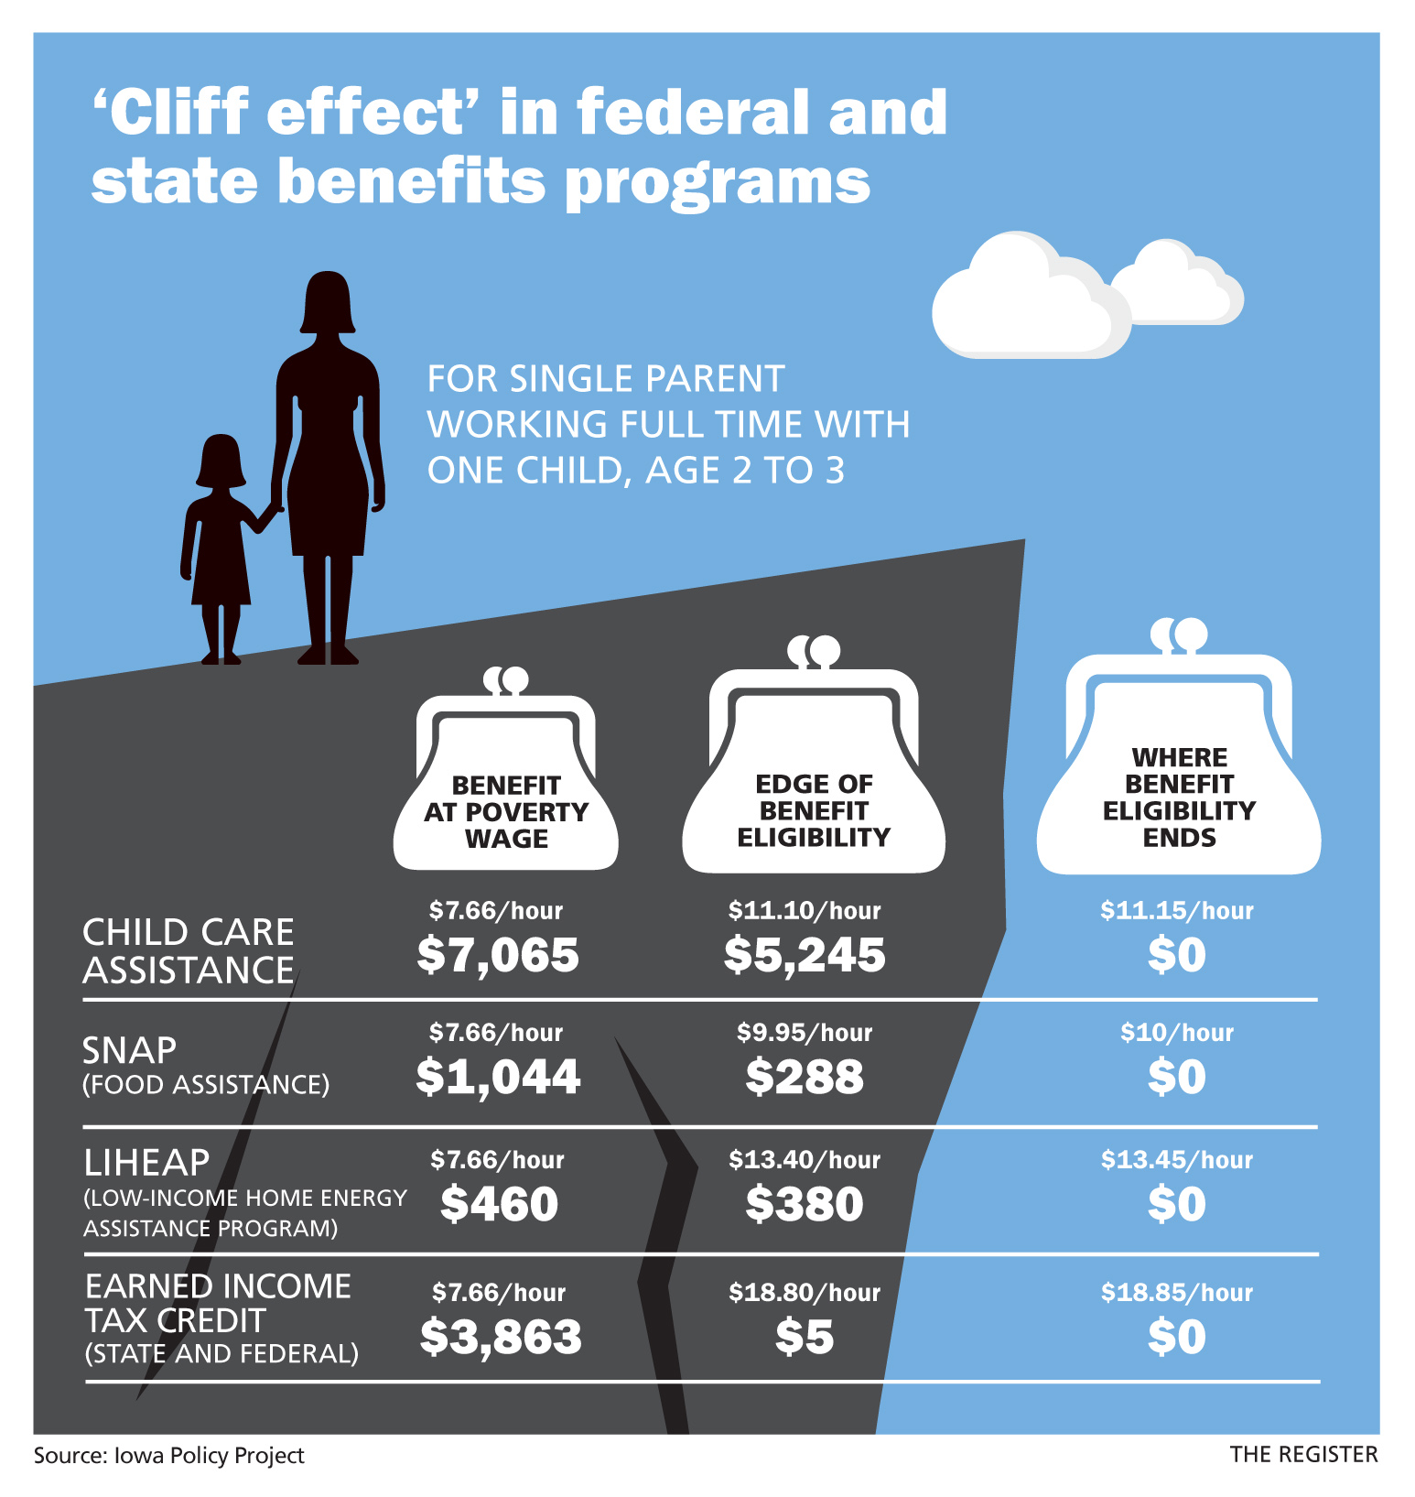
Benefits Cliff
Benefits cliffs (the “cliff effect”) refer to the sudden and often unexpected decrease in public benefits that can occur with a small increase in earnings. This happens when families receive benefits through a public assistance program, earn a raise and then become ineligible to continue receiving benefits despite being unable to sustain their household.
  National Conference of State Legislatures
Notes:
Image Source: https://www.desmoinesregister.com/story/money/business/2016/07/29/cliff-effect-why-minimum-wage-hike-could-hurt-families/87412222/
NCSL: https://www.ncsl.org/human-services/introduction-to-benefits-cliffs-and-public-assistance-programs#:~:text=Benefits%20cliffs%20(the%20%E2%80%9Ccliff%20effect,a%20small%20increase%20in%20earnings.

Slide 8
Poverty in NYC
Between 2021 and 2022, the number of New Yorkers living in poverty grew from 1.5 million to 2 million, with nearly 500,000 more people in New York living in poverty than the year prior.
The overall poverty rate increased from 18% to 23%.
The child poverty rate jumped by 66% – rising from 15% to 25%.
Most of the city’s population (56%) lives in poverty or with low incomes.
Poverty in New York City is nearly twice as high (23%) as the national poverty rate (12%)
Latino New Yorkers were twice as likely to live in poverty compared to white New Yorkers (26% vs. 13%); poverty rates were similarly elevated among Asian and Black New Yorkers (24% and 23%, respectively).
  Findings from Poverty Tracker Annual Report found here
Notes:
Source: https://robinhood.org/news/annual-poverty-tracker-report-by-robin-hood-and-columbia-finds-nyc-poverty-increased-from-18-percent-to-23-percent-in-2022-a-jump-from-1-5-to-2-million-new-yorkers-living-in-poverty/

